Slide 1
Finite State Machines
Notes:
As designers most of us are used to build deigns from discrete components or from a schematic library. In such situations the general scope of design optimisation is restricted to a few surrounding components only. That is we do not optimise the solution through several components.
With the use of HDL, the design is conceived as a data flow model and the scope or boundary of the the design is that of the problem itself.
Here I am going to present FSMs, which is a way representing most of digital design problems. Once the FSM is done, there is a corresponding coding to get the equivalent HDL.

Slide 2
Finite State Machines
Finite state machines are so named because the sequential logic that implements them can be in only a fixed number of possible states.
FSM is a systematic way of specifying any sequential logic.
Ideally suited for complex sequential logic.
Notes:
First some basic concepts are presented.
Starting with a simple state machine we will extend it to a more general and practical form. All the design problems can be mapped to the generic FSM model that we build.
Later we will list the steps for specifying a problem in FSM and see the corresponding VHDL coding that can be used.

Slide 3
What is an FSM?
State machines are a group of flip-flops, whose group-state transition pattern from one set of values to another and depends on several control inputs

Slide 4
FSM Structure
CURRENT
STATE
CURRENT
STATE
COMB.
LOGIC
for
NEXT
STATE
NEXT
STATE
CONTROL
INPUTS
OUTPUTS
STATE
REGISTER
FLIP-FLOPS
COMBO. FOR
OUTPUT
CLOCK
ASYNC
CONTROL
MEALY
PORTS

Slide 5
Mealy Machine
The outputs depend on the current state and the present value of the inputs.
Mealy outputs are asynchronous and can change in response to any changes in the inputs, independent of the clock.
Require less no. of states compared to Moore Machine.
Notes:
First some basic concepts are presented.
Starting with a simple state machine we will extend it to a more general and practical form. All the design problems can be mapped to the generic FSM model that we build.
Later we will list the steps for specifying a problem in FSM and see the corresponding VHDL coding that can be used.

Slide 6
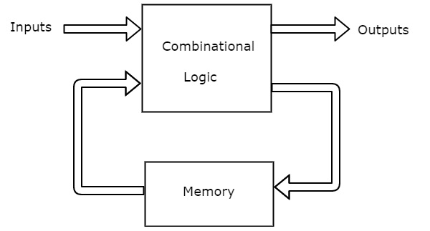
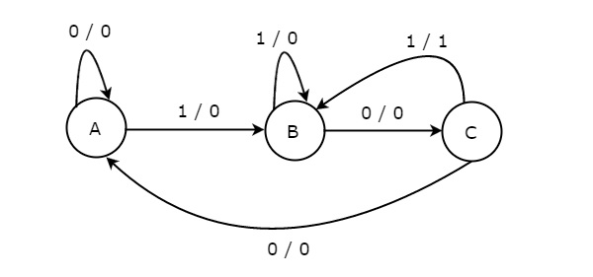
The state diagram of Mealy state machine is shown in the following figure.

Slide 7
Moore Machine
The outputs depend only on the present state.
The outputs are computed by a combinational logic block whose only inputs are the flip-flops' state outputs
The outputs change synchronously with the state transition and the clock edge.
Notes:
First some basic concepts are presented.
Starting with a simple state machine we will extend it to a more general and practical form. All the design problems can be mapped to the generic FSM model that we build.
Later we will list the steps for specifying a problem in FSM and see the corresponding VHDL coding that can be used.

Slide 8
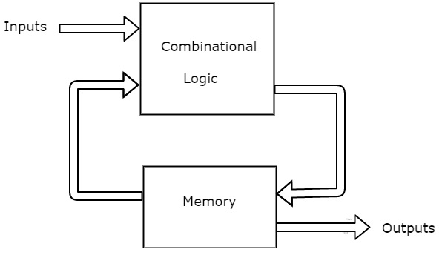
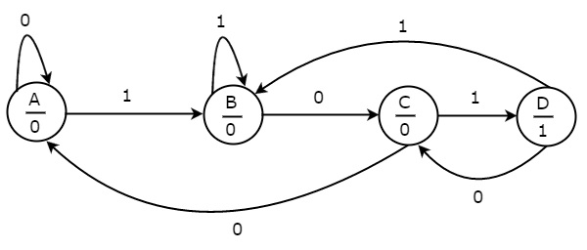
The state diagram of Moore state machine is shown in the following figure.

Slide 9

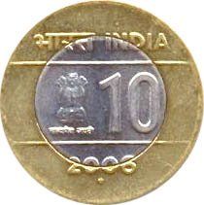
Lets take an Example…
A man has some 5/- and 10/- coins with him. A soft drink Vending Machine sells each soft drink bottle at the cost of 15/-
Analyze the controlling of the machine using State Machines.
we got only

Slide 10
Lets begin with Moore Machine
Outputs depend only on the present state.
IDLE
S1
5
10
S2
5
10
5
10
S3
S4
Open
S5
Open
S6
Open
5
10
S7
Open
S8
Open
In a Moore machine, after the system reaches one of S4..S8, Product will be released.

Slide 11
How simple is Mealy then...?
IDLE
Mealy : The Output are a function of the present state and the value of the input
5
S1
10
5
S2
10
10
5
S3
Open

Slide 12
Lets now compare in More Compact Form…..
Moore
0+Reset=1
Mealy
0+Reset/0
IDLE
[0]
IDLE
0
0/0
5
5/0
Reset=1
10
10/0
S1
[0]
S1
Reset=1/0
0
0/0
5
5/0
S2
[0]
S2
10
10/1
10
10/1
0/0
0
5/1
5
S3
[1]
S3
Reset=0/1
Reset=0

Slide 13
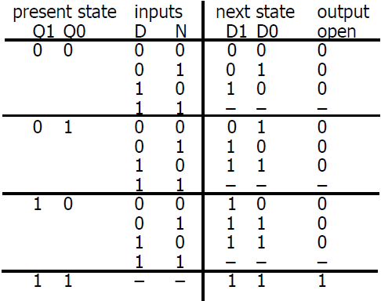
State Transition Table
Moore:
IDLE
D=10/-
N=5/-
S1
Open = Q1Q0
S2
S3
Observe : Outputs depend only on the present state

Slide 14
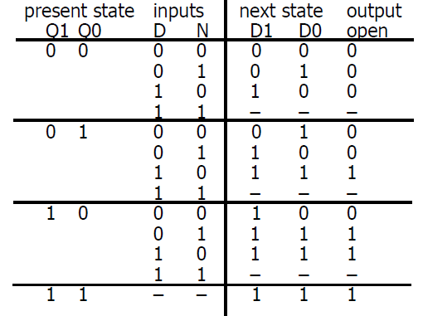
State Transition Table
Mealy:
D=10/-
N=5/-
IDLE
S1
Open = Q1Q0+Q1N+Q1D+Q0D
S2
S3
Observe : The Output are a function of the present state and the value of the input

Slide 15
Advantages of FSM:
Their simplicity make it easy for inexperienced developers to implement with little to no extra knowledge
Predictability (in deterministic FSM), given a set of inputs and a known current state, the state transition can be predicted, allowing for easy testing
FSMs are quick to design, quick to implement and quick in execution.
Easy determination of reach ability of a state, when represented in an abstract form, it is immediately obvious whether a state is achievable from another state, and what is required to achieve the state

Slide 16
Limitations
Larger systems implemented using a FSM can be difficult to manage and maintain without a well thought out design
Not suited to all problem domains, should only be used when a systems behavior can be decomposed into separate states with well defined conditions for state transitions
The conditions for state transitions are ridged, meaning they are fixed

Slide 17
THANK YOU

